Slide 1
Light as a Wave

Slide 2
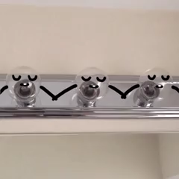
By the end of this Smart Lesson, you should be able to:
1. | Explain what a transverse wave is.
2. | Explain what the wavelength and frequency of a wave are.
3. | Understand that visible light is a part of the electromagnetic spectrum.

Slide 3
Electromagnetic radiation, or EMR, is a travelling energy that acts like a wave.
It is not quite a wave, however.
For example, EMR travels through the vacuum of space. Most waves need a medium to travel in - but not EMR. This is why you can see in space, even if no-one can hear you.

Slide 4
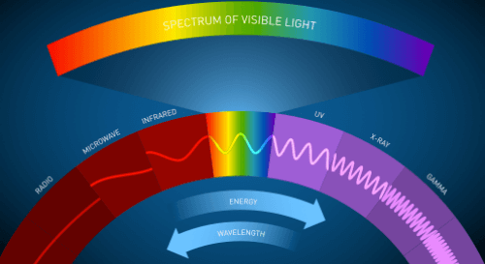
Electromagnetic radiation exists on a spectrum of different types of wave.
Light that we can see exists in the middle of this spectrum; because we can see it, it is often referred to as visible light.
Other types of EMR include infrared, microwaves, radio waves, ultraviolet, x-rays and gamma waves.

Slide 5
Light, and all other EMR waves, are transverse waves, not longitudinal waves like sound.
This is because when light moves through a medium the energy vibrates at right angles to the direction that it is travelling in.
Ocean waves are also transverse waves!

Slide 6
Light travels with a velocity, and has a frequency and wavelength.
However, unlike sound waves, light does not need to travel through a medium! This is why light from the Sun can travel through space to reach the Earth.
Light moves through space as a little parcel of energy, not needing to travel through particles like other waves do.

Slide 7
Light is the fastest thing in the universe!
Light travels at 3.0×10⁸ m/s in a vacuum. This is the same as travelling 300,000 kilometres in one second.
This is the speed limit of the universe. It is impossible for anything to travel faster than the speed of light!
Light and the other EMR waves are the only things that can travel at this speed.

Slide 8
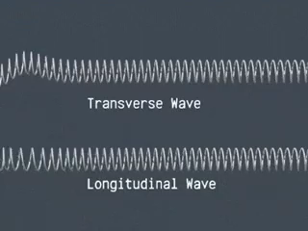
It is important to be able to distinguish between longitudinal and transverse waves.
Sound travels as a longitudinal wave - the particles of the medium vibrate in the direction of the wave's movement.
Light waves travel as transverse waves - the particles of the medium vibrate at a right angle to the wave's movement.

Slide 9
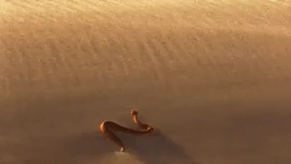
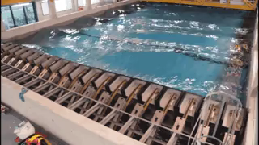
A transverse wave wiggles up and down (or back and forth) as it moves forwards, much like a snake.
The most well-known type of transverse wave is a water wave. The particles of water bobs up and down as a wave moves forward from its point of origin.

Slide 10
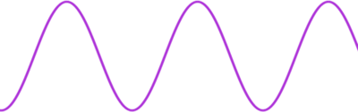
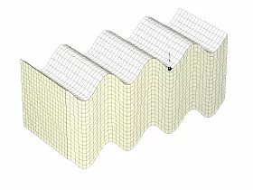
A transverse wave is usually drawn like this:
When the wave passes through a medium, none of the particles of the medium move forward - they just go up and down. Light, however, moves forward with the wave because it is the wave.

Slide 11
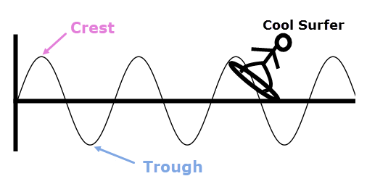
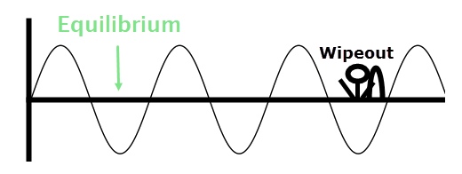
The top of a wave is called the crest, and the bottom of the wave is called the trough.
Half-way between the crest and trough is the equilibirum - this is where all parts of the wave would be if the system was at rest.

Slide 12
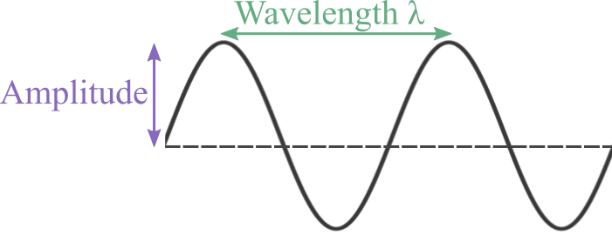
Waves also have a wavelength and an amplitude.
The height of a crest from equilibrium is called the amplitude; this is also the distance from equilibrium to trough. So the height of a wave is double the amplitude.
The distance between two peaks or two troughs is the wavelength.

Slide 13
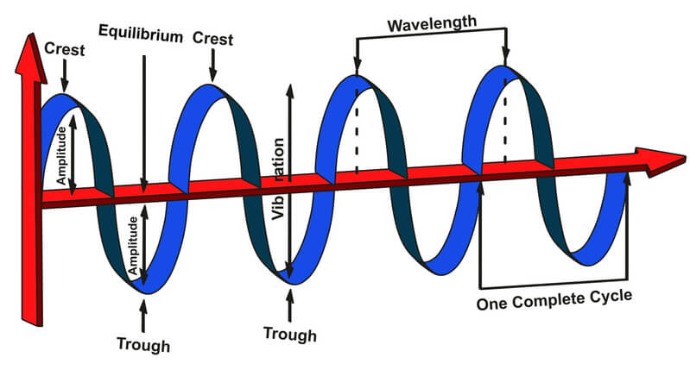
A wave consists of many wavelengths.
One complete wave cycle, from crest to crest, takes place over one wavelength.
The frequency of a light wave is the number of crests that pass a certain point in one second.
Visible light has an extremely high frequency and a very short wavelength.

Slide 14
